Slide 1
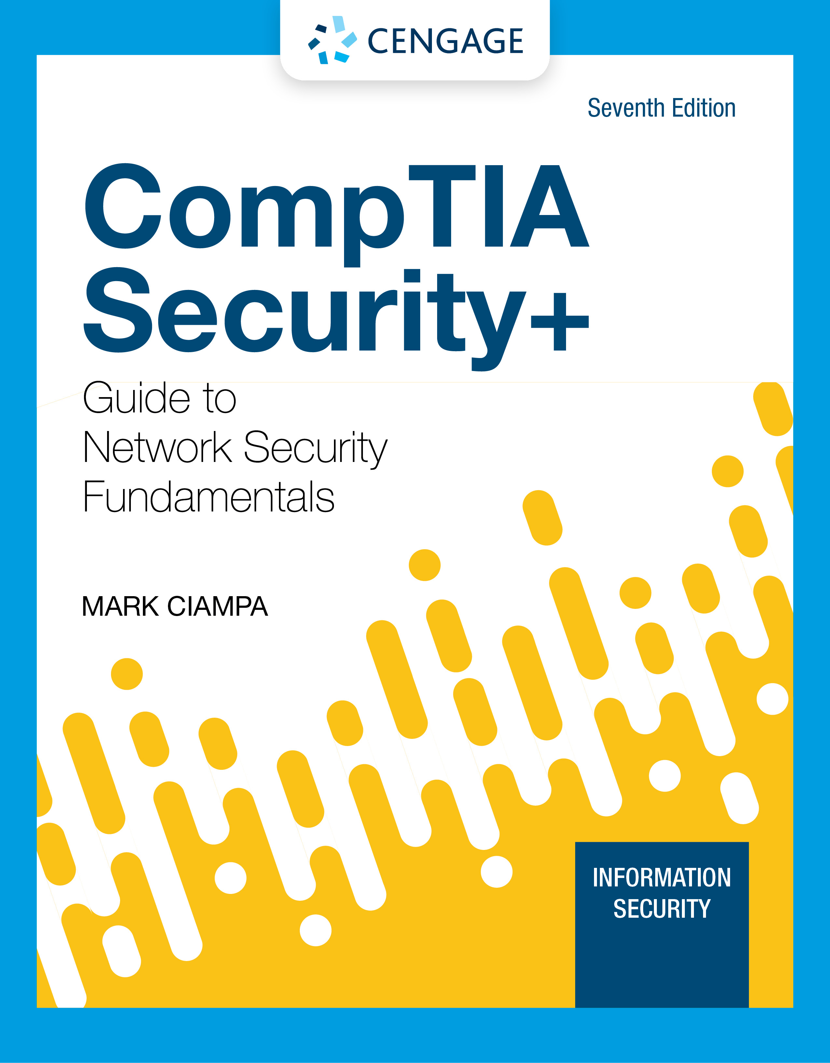
Module 8: Networking Threats, Assessments, and Defenses
CompTIA Security+ Guide
to Network Security Fundamentals, 7th Edition

Slide 2
Module Objectives
By the end of this module, you should be able to:
1. Describe the different types of networking-based attacks
2. List the different network assessment tools
3. Explain how physical security defenses can be used

Slide 3
Attacks on Networks
Threat actors place a high priority on targeting networks in their attacks
Exploiting a single network vulnerability can expose hundreds or thousands of devices
Attacks that target a network or a process that relies on a network include:
Interception attacks
Layer 2 attacks
DNS attacks
Distributed denial of service attacks
Malicious codding and scripting attacks

Slide 4
Interception Attacks (1 of 5)
Man-in-the-Middle (MITM)
In an MITM, a threat actor is positioned in a communication between two parties
The goal of an MITM attack is to eavesdrop on the conversation or impersonate one of the parties
A typical MITM attack has two phases:
The first phase is intercepting the traffic
The second phase is to decrypt the transmissions

Slide 5
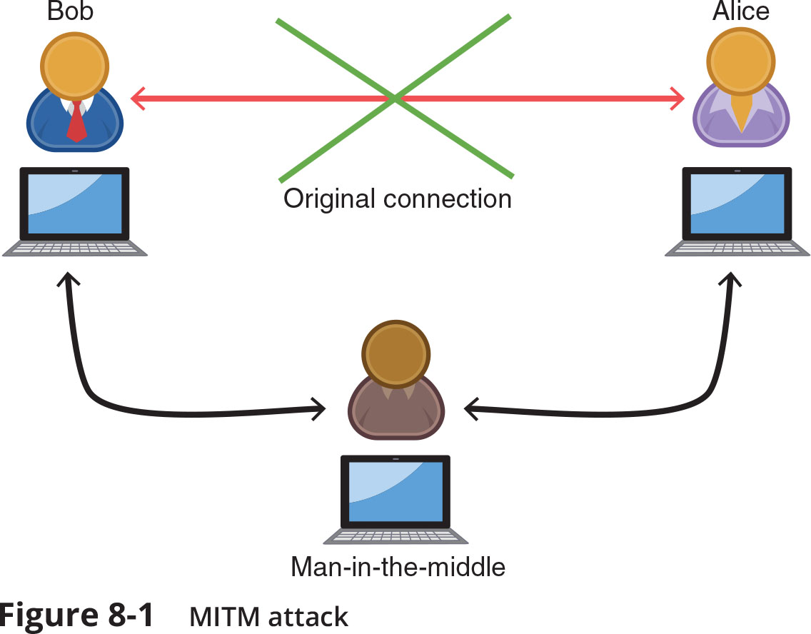
Interception Attacks (2 of 5)
Figure 8-1 MITM attack

Slide 6
Interception Attacks (3 of 5)
Session Replay
A replay attack makes a copy of a legitimate transmission before sending it to the recipient
Attacker uses the copy at a later time
Example: capturing logon credentials
Threat actors use several techniques for stealing an active session ID:
Network attacks (hijacks and altered communication between two users)
Endpoint attacks (cross-site scripting, Trojans, and malicious JavaScript coding)

Slide 7
Interception Attacks (4 of 5)
Man-in-the-Browser (MITB)
A man-in-the-browser (MITB) attack intercepts communication between parties to steal or manipulate the data
It occurs between a browser and the underlying computer
A MITB attack usually begins with a Trojan infecting the computer and installing an “extension” into the browser configuration
When the browser is launched the extension is activated
Extension waits for a specific webpage in which a user enters information such as account number and password for a financial institution
When users click “Submit” the extension captures all the data from the fields on the form
May even modify some of the data

Slide 8
Interception Attacks (5 of 5)
Man-in-the-Browser (MITB) (continued)
Advantages to a MITB attack:
Most MITB attacks are distributed through a Trojan browser extension making it difficult to recognize that malicious code has been installed
An infected MITB browser might remain dormant for months until triggered by the user visiting a targeted website
MITB software resides exclusively within the web browser, making it difficult for standard anti-malware software to detect it

Slide 9
Layer 2 Attacks (1 of 2)
The OSI reference model separates networking steps into a series of seven layers
Within each layer, different networking tasks are performed that cooperate with the tasks in the layers immediately above and below it
Layer 2, the Data Link Layer, is responsible for dividing the data into packets
A compromise at Layer 2 can affect the entire communication
Address Resolution Protocol Poisoning
If the IP address for a device is known but the MAC address is not, the sending computer sends an Address Resolution Protocol (ARP) packet to determine the MAC address
MAC addresses are stored in an ARP cache for future reference
ARP poisoning
Relies upon MAC spoofing, which is imitating another computer by means of changing the MAC address

Slide 10
Layer 2 Attacks (2 of 2)
Media Access Control Attacks
Other attacks manipulate MAC addresses through spoofing
Two common attacks involving spoofing MAC addresses are MAC cloning and MAC flooding
In a MAC cloning attack, threat actors discover a valid MAC address of a device connected to a switch
They spoof the MAC address on and the switch changes its MAC address table to reflect the MAC address with the port to which the attacker’s device is connected
A MAC flooding attack is another attack based on spoofing, MAC cloning, and the MAC address table of a switch
A threat actor overflows the switch with Ethernet packets that have been spoofed so that every packet contains a different source MAC address

Slide 11
DNS Attacks (1 of 3)
Domain Name System (DNS) is a hierarchical name system for matching computer names and IP addresses
A DNS-based attack substitutes a DNS address so that the computer is silently redirected to a different device
A successful DNS attack has two consequences:
URL redirection
Domain reputation
Attacks using DNS include DNS poisoning and DNS hijacking
DNS Poisoning
DNS poisoning modifies a local lookup table on a device to point to a different domain
Two locations for DNS poisoning
Local host table
External DNS server

Slide 12
DNS Attacks (2 of 3)
DNS Hijacking
DNS hijacking is intended to infect an external DNS server with IP addresses that point to malicious sites
DNS hijacking has the advantage of redirecting all users accessing the server
Attackers attempt to exploit a protocol flaw and convince the authentic DNS server to accept fraudulent DNS entries sent from the attackers’ DNS server
If the DNS server does not correctly validate DNS responses to ensure they have come from an authoritative source, it stores the fraudulent entries locally and serves them to users
Spreading them to other DNS servers

Slide 13
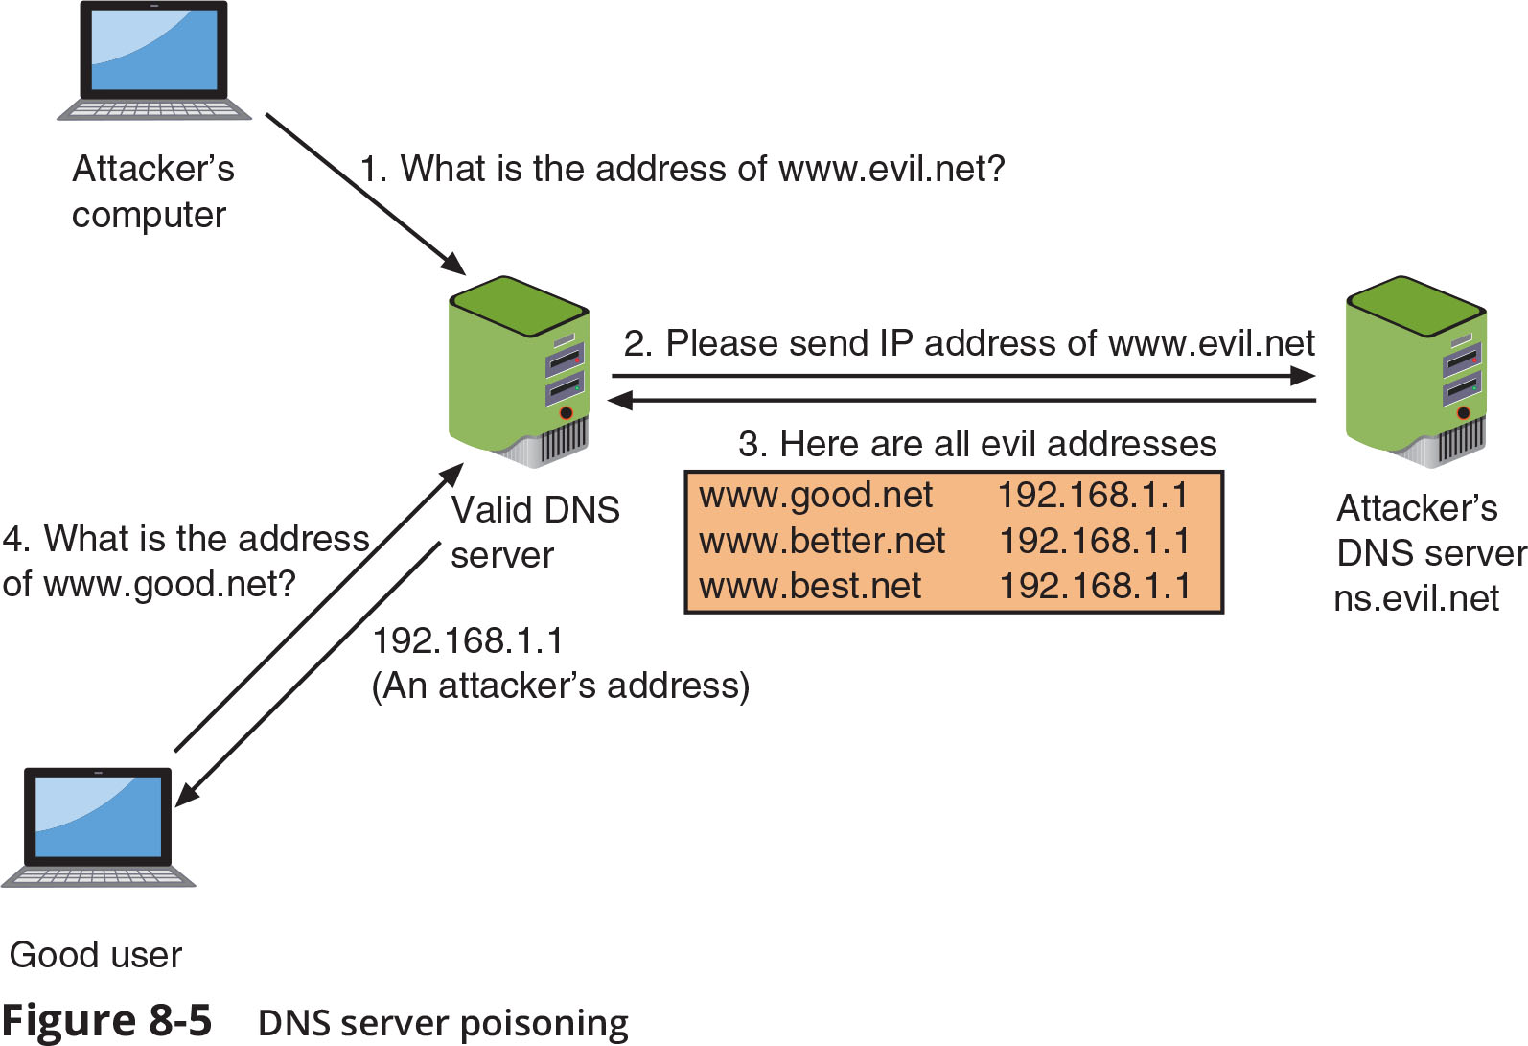
DNS Attacks (3 of 3)
Figure 8-5 DNS server poisoning

Slide 14
Distributed Denial of Service Attack
A denial of service (DoS) attack is a deliberate attempt to prevent authorized users from accessing a system by overwhelming it with requests
Most DoS attacks today are distributed denial of service (DDoS)
Using hundreds or thousands of devices flooding the server with requests
The devices participating in a DDoS attack are infected and controlled by threat actors so that users are completely unaware that their endpoints are part of a DDoS attack

Slide 15
Malicious Coding and Scripting Attacks (1 of 3)
Some network attacks come from malicious software code and scripts
These attacks use PowerShell, Visual Basic for Applications, the coding language Python, and the Linux/UNIX Bash
PowerShell is a task automation and configuration management framework from Microsoft
Administrative tasks are performed by cmdlets, which are specialized .NET classes that implement a specific operation
PowerShell allows attackers to inject code from the PowerShell environment into other processes without first storing any malicious code on the hard disk
Commands can then be executed while bypassing security protections and leave no evidence behind

Slide 16
Malicious Coding and Scripting Attacks (2 of 3)
Visual Basic for Applications (VBA)
VBA is an event-driven Microsoft programming language
VBA is most often used to create macros, which are used to automate a complex task or a repeated series of tasks
Macros date back to late 1990s but continue to be a key attack vector
Due to the impact of macro malware, Microsoft has implemented several protections:
Protected View
Trusted Documents
Trusted Location

Slide 17
Malicious Coding and Scripting Attacks (3 of 3)
Python
Python is a popular programming language that can run on several OS platforms
There are several best practices to follow when using Python so that the code does not contain vulnerabilities:
Use the latest version of Python
Stay current on vulnerabilities within Python
Be care when formatting strings in Python
Download only vetted Python libraries
Bash
Bash is the command language interpreter for the Linux/UNIX OS
Bash scripting is using Bash to create a script
Exploits have taken advantage of vulnerabilities in Bash

Slide 18
Knowledge Check Activity 1
In which type of attack is the threat actor positioned between two parties and alters the transmission to eavesdrop or impersonate one of the parties?
a. MITB
b. MAC cloning
c. MITM
d. Session replay

Slide 19
Knowledge Check Activity 1: Answer
In which type of attack is the threat actor positioned between two parties and alters the transmission to eavesdrop or impersonate one of the parties?
Answer: c. MITM
In a man-in-the-middle (MITM) attack, a threat actor is positioned between two parties with the goal of eavesdropping or impersonating a party. In an MITM attack, the transmission is altered whereas in a session replay attack, a copy is made of a legitimate transmission for the purpose of replaying it later.

Slide 20
Tools for Assessment and Defense
Several assessment tools determine the strength of a network
Other tools can be used to create a stronger network defense
Both types of tools can be categorized into network reconnaissance and discovery tools, Linux file manipulation tools, and packet capture and replay tools

Slide 21
Network Reconnaissance and Discovery Tools
Name | Source | Description
theHarvester | Kali Linux | Provides information about email accounts, user names, and hostnames/subdomains from different public sources
dnsenum | Kali Linux | List DNS information of a domain
sn1per | XeroSecurity | Penetration testing tool
Cuckoo | Cuckoo | Automated malware analysis system
Nessus | Tenable | Vulnerability assessment tool
scanless | Vesche | Tool for using websites to perform port scan
nmap | Nmap | Network discovery and security auditing

Slide 22
Linux File Manipulation Tools
Tool name | Description | Example
head | Display the first 10 lines of a file | head etc/snort/snort.conf
tail | Display the last 10 lines of a file | tail etc/snort/snort.conf
cat | Display an entire file | cat etc/snort/snort.conf
grep | Search for keyword | grep apache1
chmod | Change file permissions | chmod 774 rules
logger | Add content to syslog file | logger comment

Slide 23
Scripting Tools
Scripting tools are used to create scripts that facilitate tasks
PowerShell is one of the most powerful scripting tools
Scripts can also be created when using Secure Shell (SSH)
OpenSSL is another tool that supports scripting
It is a cryptography library that offers open source applications of the TLS protocol

Slide 24
Packet Capture and Replay Tools (1 of 2)
Collecting and analyzing data packets that cross a network can provide valuable information
Packet analysis typically examines the entire contents of the packet, which can be used extensively for security
It can detect unusual behavior that could indicate the presence of malware, search for unusual domains or IP address endpoints, and discover regular connections to a threat actor’s command and control (C&C) server
Wireshark is a popular GUI packet capture and analysis tool
Tcpdump is a command-line packet analyzer
Tcpreplay is a tool for editing packets and then “replaying” the packets back onto the network to observe their behavior

Slide 25
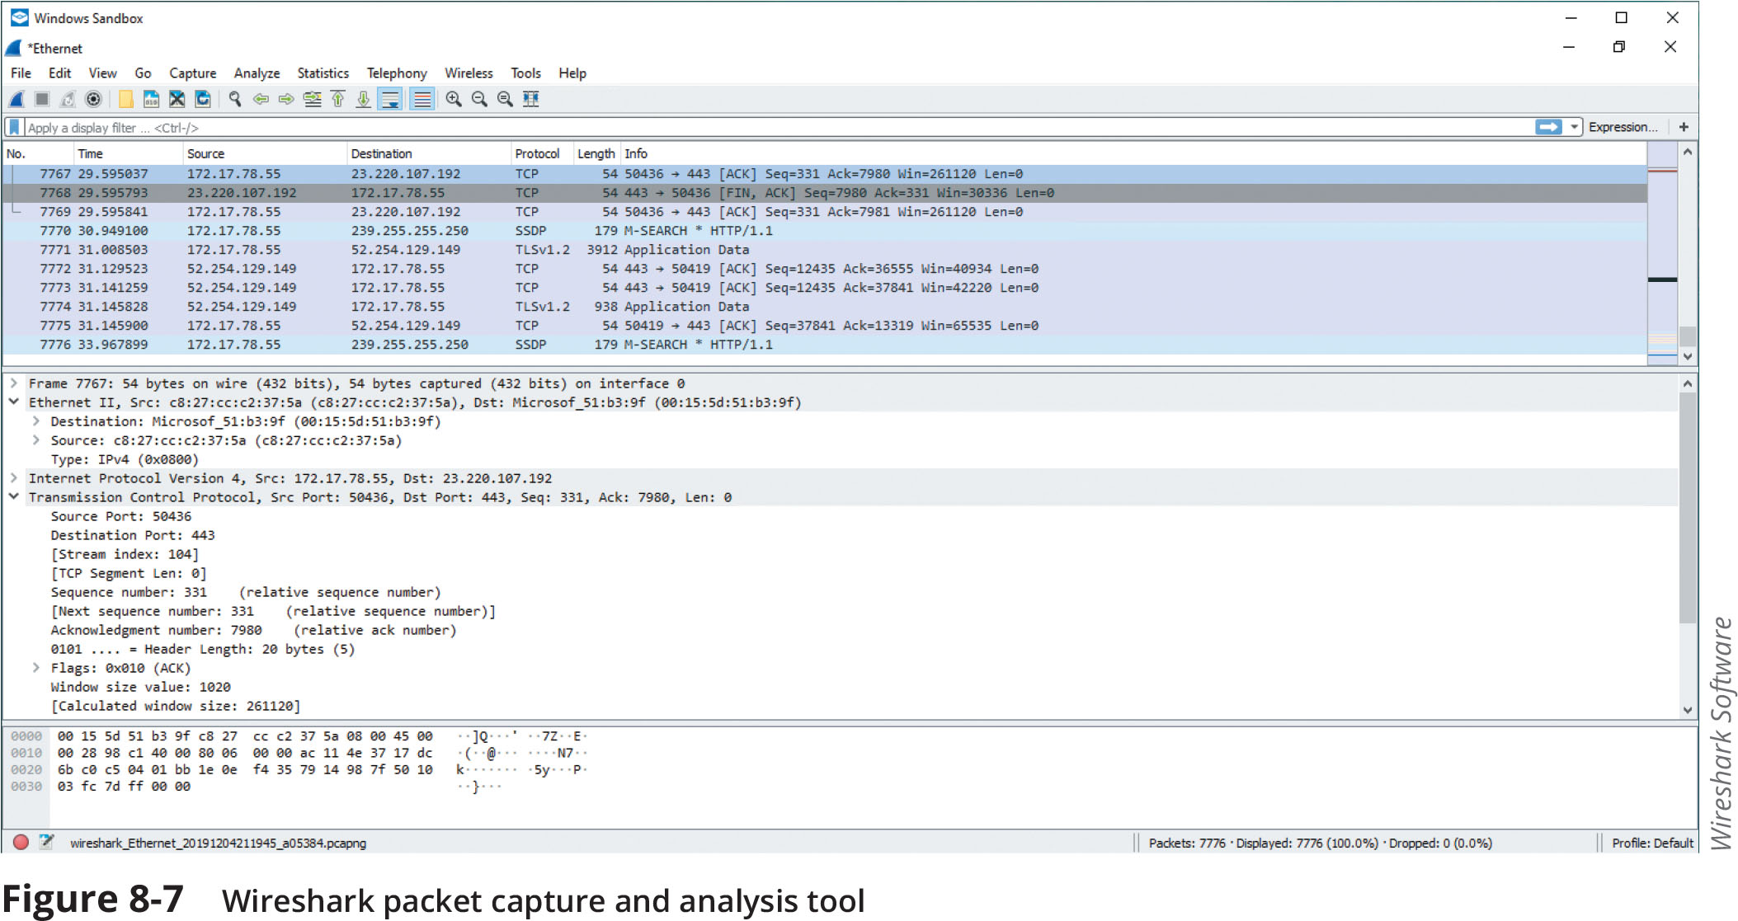
Packet Capture and Replay Tools (2 of 2)
Figure 8-7 Wireshark packet capture and analysis tool

Slide 26
Knowledge Check Activity 2
Which of the following is a GUI tool that it used to capture and analyze packets?
a. Tcpdump
b. PowerShell
c. Tcpreplay
d. Wireshark

Slide 27
Knowledge Check Activity 2: Answer
Which of the following is a GUI tool that it used to capture and analyze packets?
Answer: d. Wireshark
Wireshark is a GUI packet capture and analysis tool. Tcpdump is a command-line packet analyzer, Tcprelay is used to edit and replay packets, and PowerShell is a scripting tool.

Slide 28
Physical Security Controls
Physical security involves preventing a threat actor from physically accessing the network
Physical security controls include:
External perimeter defenses
Internal physical security controls
Computer hardware security

Slide 29
External Perimeter Defenses (1 of 2)
Industrial camouflage is an attempt to make the physical presence of a building as nondescript as possible
When camouflage is not possible, external perimeter defenses must be used
Barriers
Barriers acts as passive security devices
Fencing is usually a permanent structure to keep unauthorized personnel out
It is usually accompanied by signage that explains the area is restricted
A barricade is generally designed to block the passage of traffic but not designed to keep out individuals
A bollard is a short but sturdy vertical post that is used as a vehicular traffic barricade to prevent a car from ramming into a secured area

Slide 30
External Perimeter Defenses (2 of 2)
Personnel
Human security guards who patrol and monitor restricted areas are most often used as an active security defense
In settings that require a higher level of protection, two security guards may be required
Some guards are responsible for monitoring activity captured by video surveillance cameras that transmit a signal to a specific and limited set of receivers called closed circuit television (CCTV)
Drones, also called unmanned aerial vehicles (UAVs), include cameras for monitoring activity
Robot sentries that patrol and use CCTV with object detection are increasingly being used in public areas
Sensors
To supplement the work of security guards, sensors can be placed in strategic locations to alert guards by generating an audible alarm of an unexpected or unusual action

Slide 31
Internal Physical Security Controls (1 of 5)
Internal physical access security controls include:
Locks
Secure areas
Protected cable distribution
Fire suppression
Locks
Physical locks require a key or other device to open doors or cabinets
Electronic locks use buttons that must be pushed in the proper sequence to open the door
Smart locks use a smartphone to send a code via wireless Bluetooth to open a door
Fingerprint locks have a pad that scans a user’s fingerprint

Slide 32
Internal Physical Security Controls (2 of 5)
Secure Areas
A demilitarized zone (DMZ) in cybersecurity is an area that separates threat actors from defenders
A mantrap is designed as an air gap to separate a nonsecure area from a secured area (see Figure 8-11 on the following slide)
A mantrap device monitors and controls two interlocking doors to a vestibule
Another area that must be secured is the data center that houses the on-premises network, server, and storage equipment

Slide 33
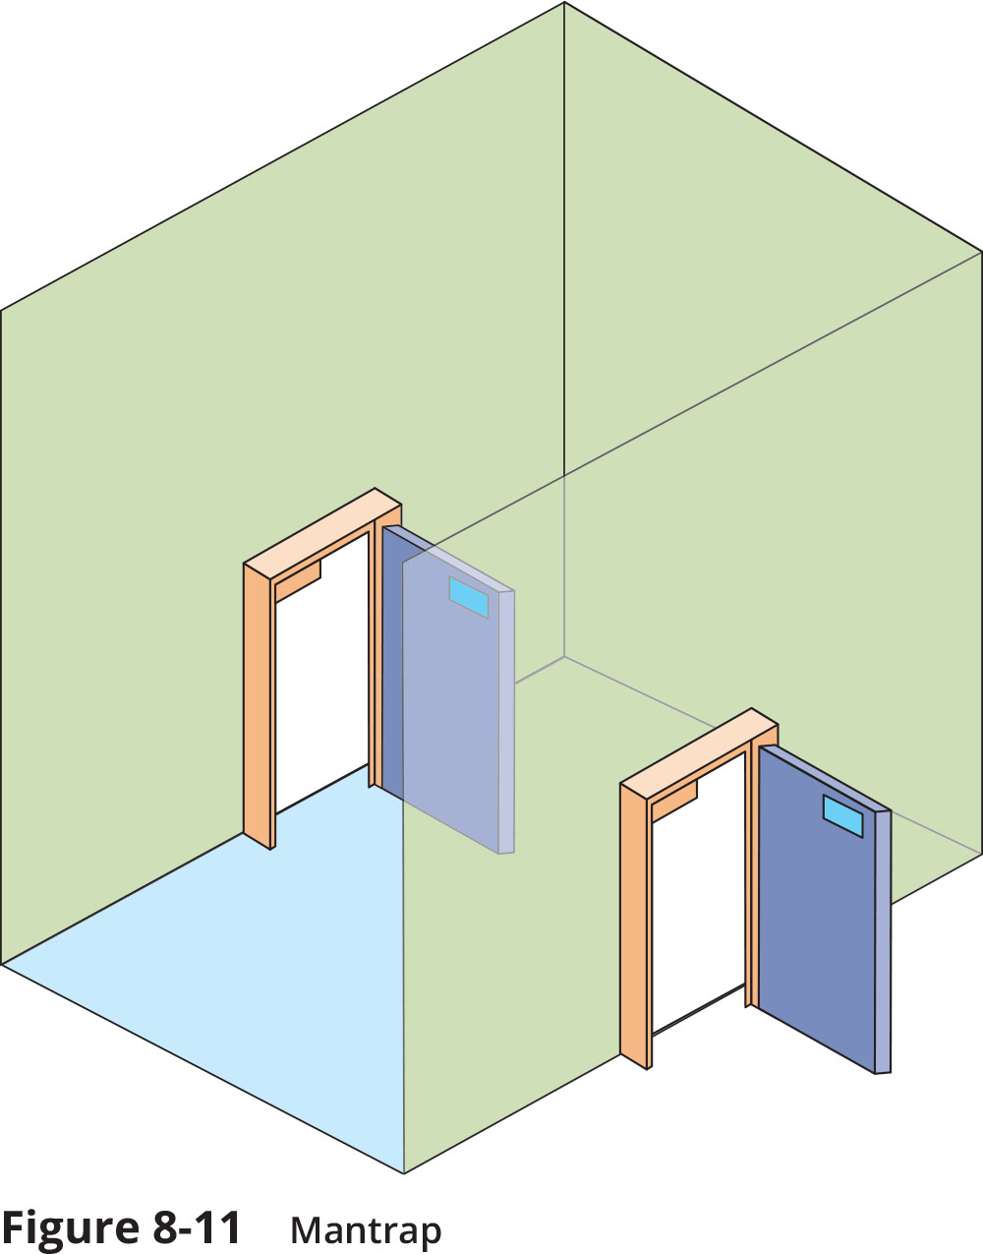
Internal Physical Security Controls (3 of 5)
Figure 8-11 Mantrap

Slide 34
Internal Physical Security Controls (4 of 5)
Protected Cable Distribution
A protected cable distribution (PDS) is a system of cable conduits used to protect classified information that is being transmitted between two secure areas
Two types of PDS are commonly used:
In a hardened carrier PDS, the data cables are installed in a conduit constructed of special electrical metallic tubing and all connections between segments are permanently sealed with welds or special sealants
In an alarmed carrier PDS, the carrier system is deployed with specialized optical fibers in the conduit that can sense acoustic vibrations that occur when an intruder attempts to gain access to cables

Slide 35
Internal Physical Security Controls (5 of 5)
Fire Suppression
In a data center containing electronic equipment, using water or a handheld fire extinguisher is not recommended because it can contaminate equipment
Stationary fire suppression systems are integrated into the building’s infrastructure and release fire suppressant
Systems can be classified as:
Dry chemical systems that disperse a fine, dry powder over the fire
Clean agent systems that extinguish a fire by reducing heat, removing or isolating oxygen, or inhibiting the chemical reaction

Slide 36
Computer Hardware Security (1 of 2)
Computer hardware security is the physical security that involves protecting endpoint hardware
A cable lock can be inserted into the security slot of a portable device to secure the device
For storage, a laptop can be placed in a safe or a vault
These can be prewired for electrical power as well as wired network connections
Computer systems, printers, and similar electronic devices emit electromagnetic fields, which can result in interference (called electromagnetic interference or EMI)
Electromagnetic spying can be defined as picking up electromagnetic fields and reading data that is producing them
A Faraday cage is a metallic enclosure that prevents entry or escape of an electromagnetic field. A Faraday cage can prevent electromagnetic spying and remote wiping of electronic devices.

Slide 37
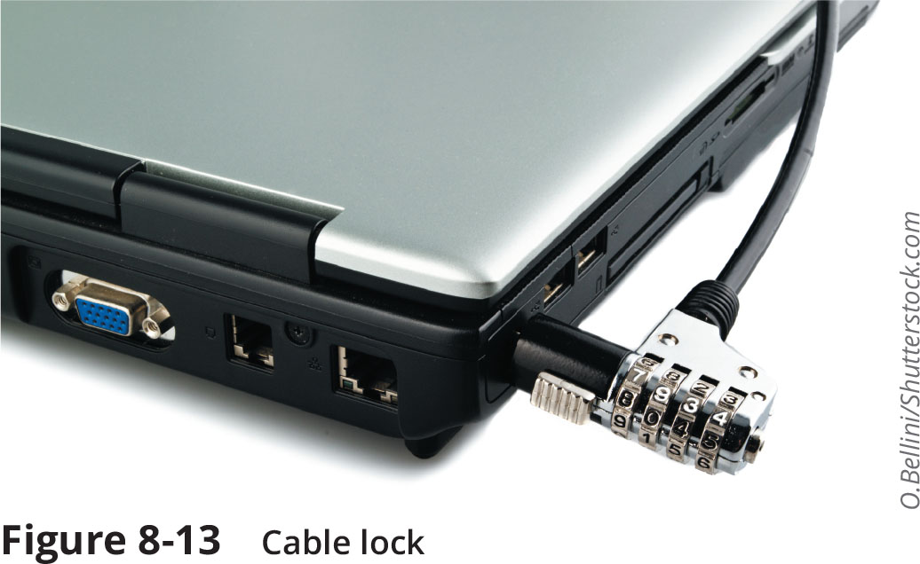
Computer Hardware Security (2 of 2)
Figure 8-13 Cable lock

Slide 38
Knowledge Check Activity 3
What can be used to secure electronic devices from electromagnetic spying and shield them from EMI?
a. Demilitarized zone
b. PDS
c. Faraday cage
d. Mantrap

Slide 39
Knowledge Check Activity 3: Answer
What can be used to secure electronic devices from electromagnetic spying and shield them from EMI?
Answer: c. Faraday cage
A Faraday cage is a metallic enclosure that prevents the entry or escape of an electromagnetic field.

Slide 40
Self-Assessment
Consider the three learning objectives of this module:
1. Describe the different types of networking-based attacks
2. List the different network assessment tools
3. Explain how physical security defenses can be used
For each objective, write two or three sentences explaining what you learned about each of these objectives from reading the module and performing the exercises.

Slide 41
Summary (1 of 2)
Some attacks are designed to intercept network communications
Man-in-the-middle and replay attacks are examples
Some types of attacks inject “poison” into a normal network process to facilitate an attack
DNS poisoning modifies a local lookup table on a device to point to a different domain, which is usually a malicious DNS server controlled by a threat actor that will redirect traffic to a website designed to steal user information or infect the device with malware
Several successful network attacks come from malicious software code and scripts
There are several different assessment tools for determining the strength of a network
Collecting and analyzing data packets that cross a network can provide a wealth of valuable information

Slide 42
Summary (2 of 2)
An often-overlooked consideration when defending a network is physical security: preventing a threat actor from physically accessing the network is as important as preventing the attacker from accessing it remotely
While barriers act as passive devices to restrict access, personnel are considered active security elements
In the event that unauthorized personnel defeat external perimeter defenses, they should then face internal physical access security
A demilitarized zone (DMZ) is an area that separates threat actors from defenders (also called a physical air gap)

